Slide 1
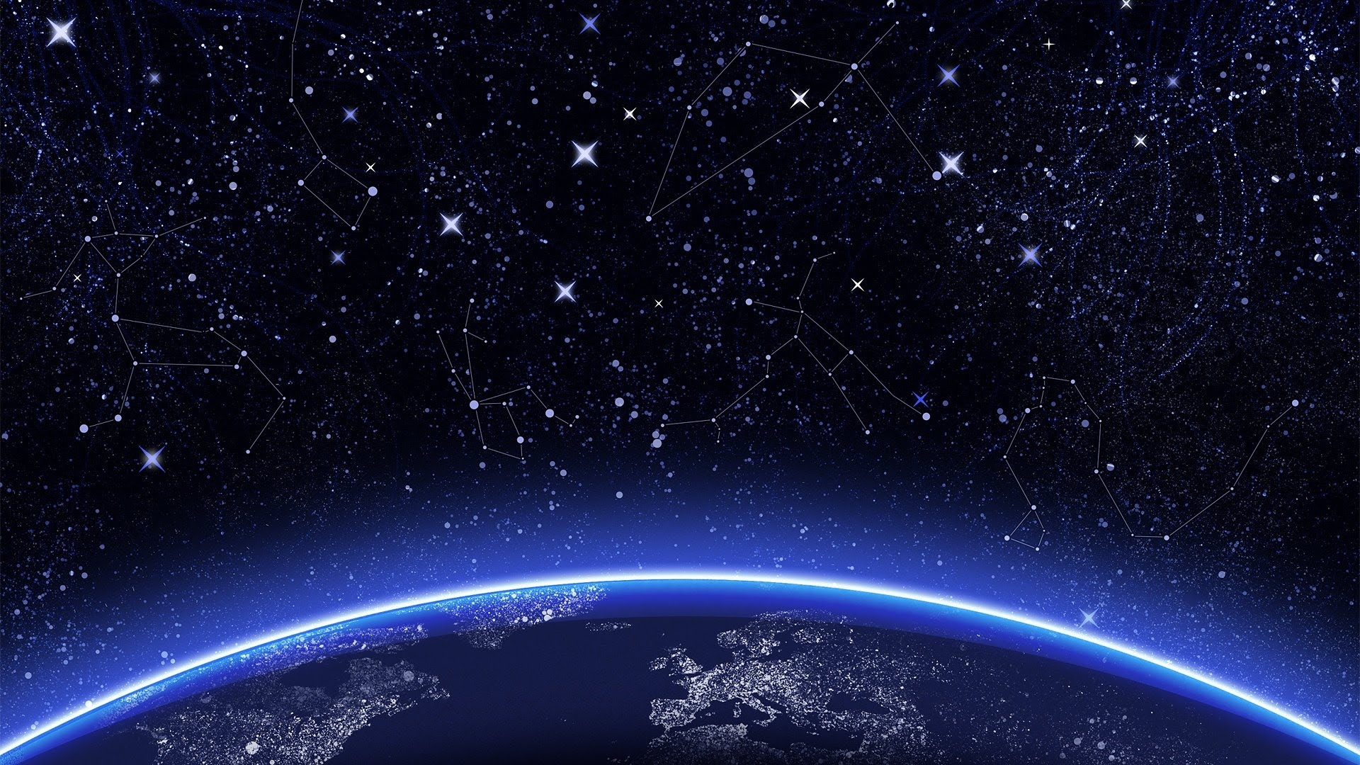
Mayday, Mayday, mayday!
Warning Danger ahead!
Team: Semi Colon

Slide 2
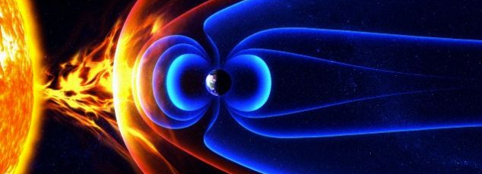
Solar wind: are air crew at risk?

Slide 3
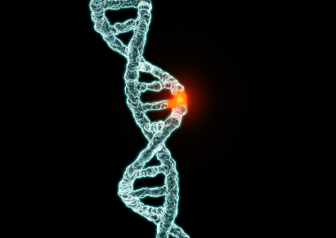
Risks of ionization radiation
DNA mutation
Increasing risk of cancer
Reproductive problems such as miscarriage and birth defects

Slide 4
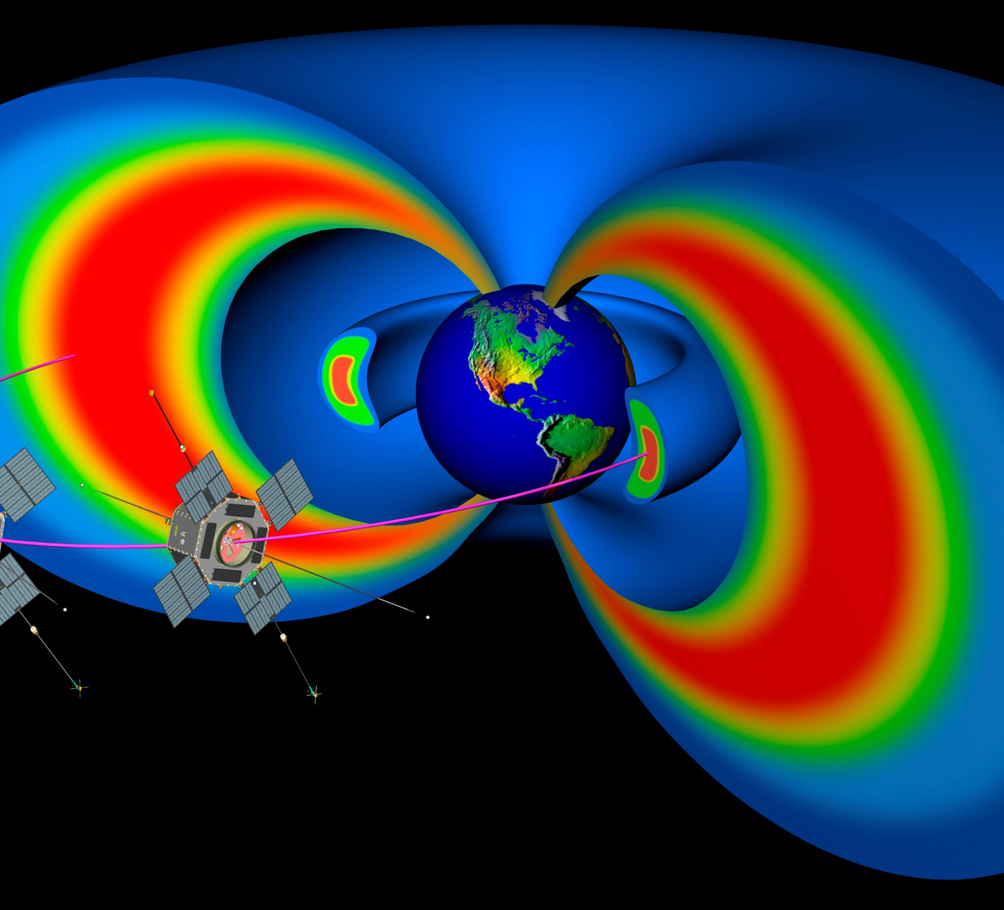
The earth is actually a Magnet

Slide 5
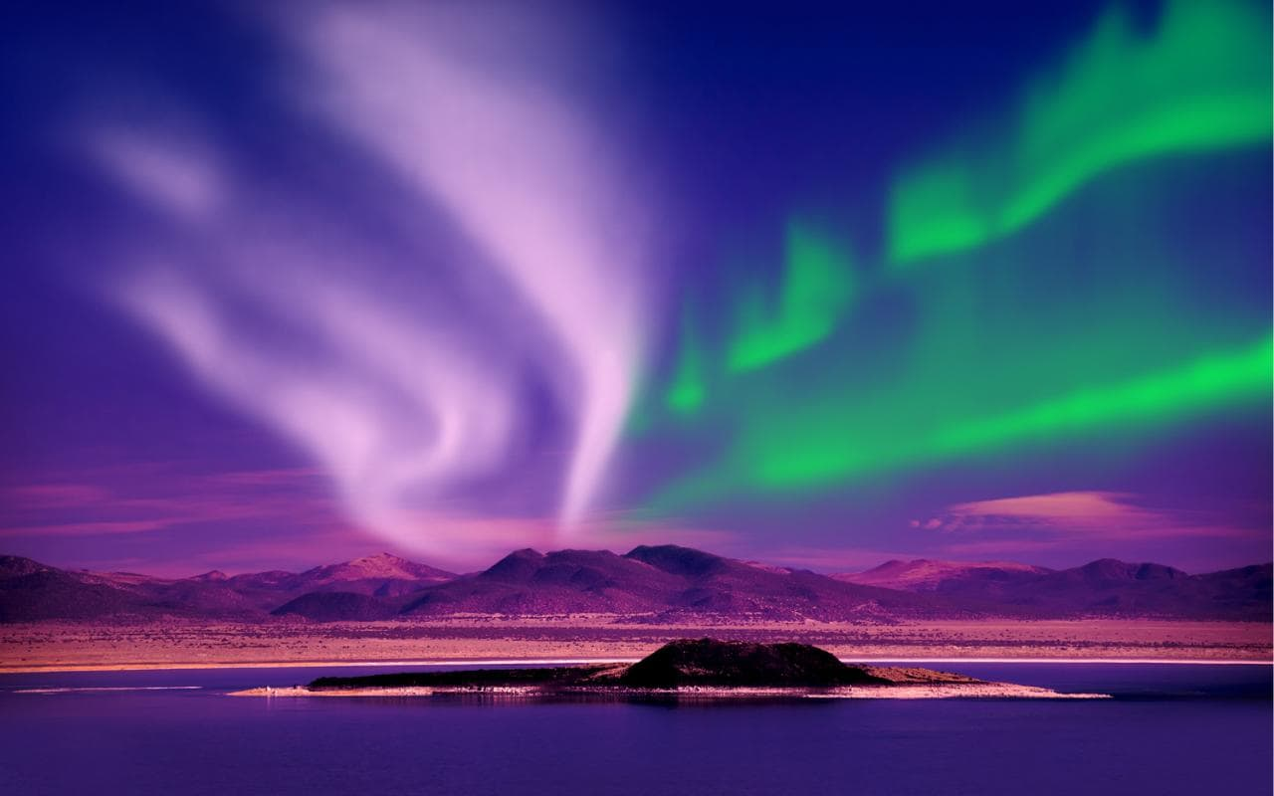
Aurora
Electrons collide with the earth’s atmosphere.
Thus exciting the atoms and molecules to higher energy states.
When they relax back down to lower energy states, they release their energy in the form of light.

Slide 6
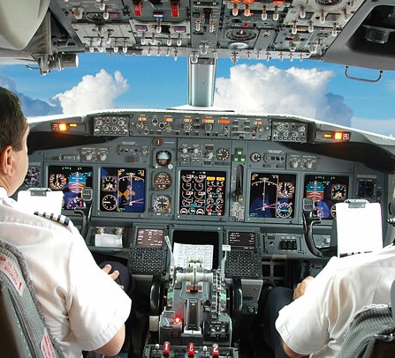
Airline pilots and crew are exposed to higher levels of radiation
Annual exposure ranges from 0.2 to 5 mSv per year.

Slide 7
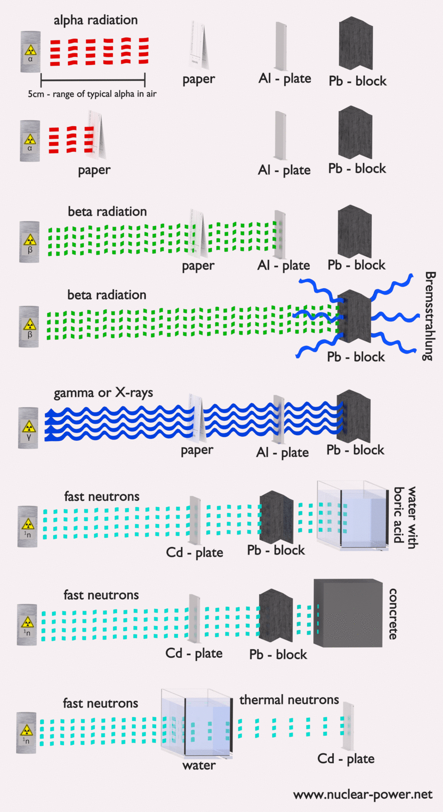
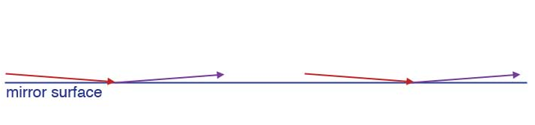
The solution
Shielding
Radiation barrier:
Aluminized polymer film
Reflection
Rerouting flights

Slide 8
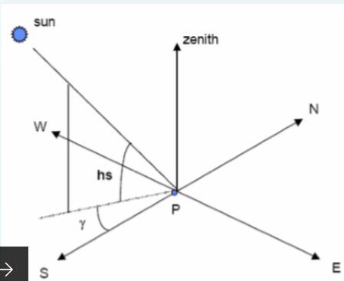
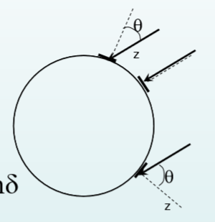
Azimuth and Zenith Angles
Azimuth: angle between the projection of the straight line joins the site with the centers of the sun on the horizontal plane and due south.
Zenith: is incidence angle of sunbeam on a horizontal surface.

Slide 9
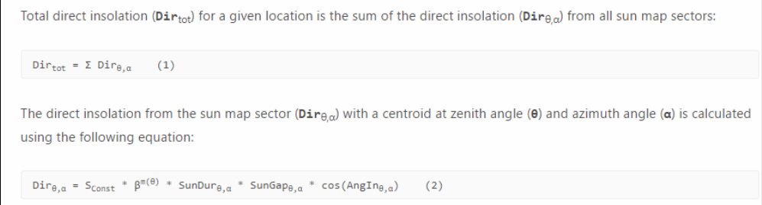
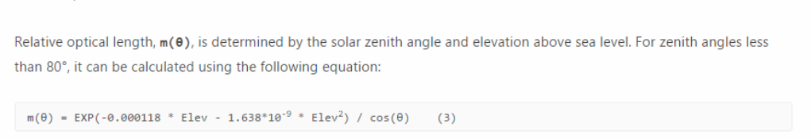
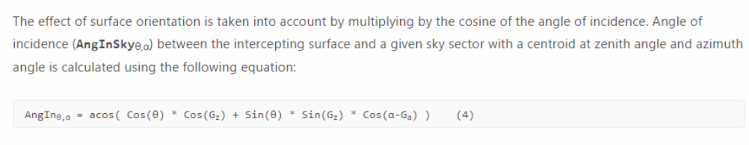


Slide 10
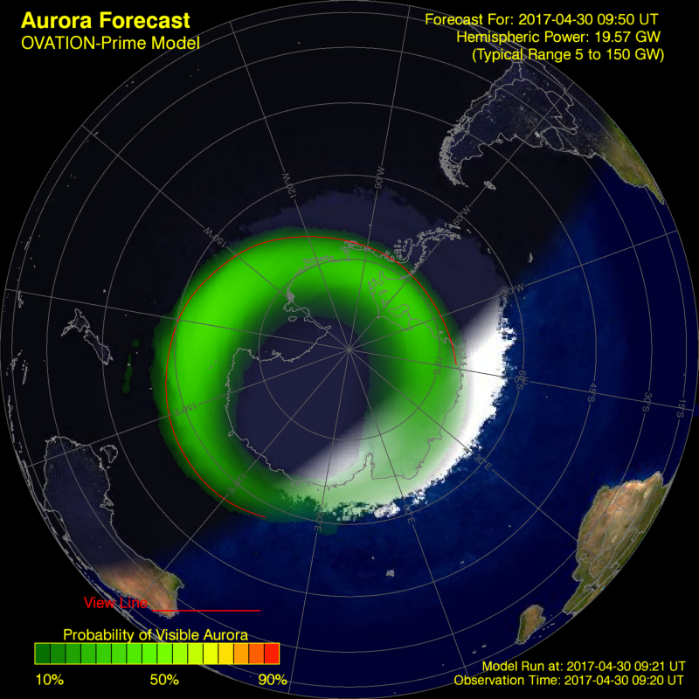
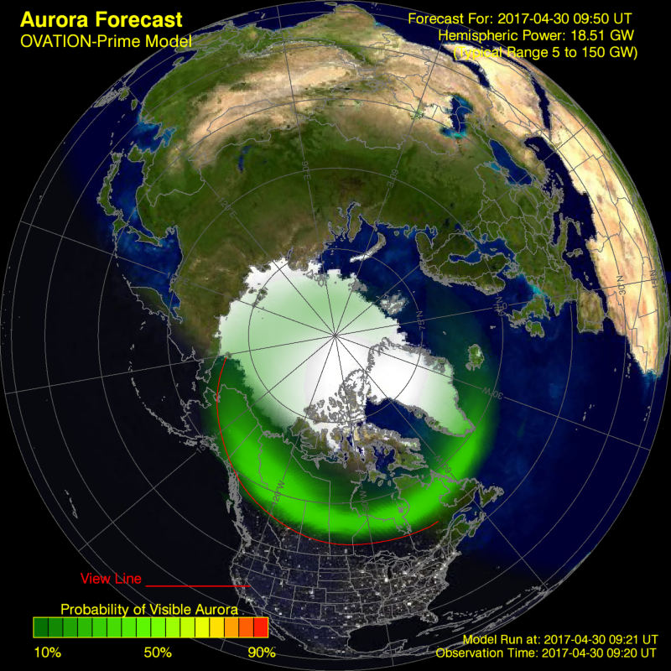
Difference between radiation in northern pole and south pole
Southern lights
Northern lights

Slide 11
Thank you

